Slide 1
Are PNNs essential for pup retrieval learning?

Slide 2
Notes:
Summary of changes in PNN density between genotypes in maternal behavior
context. (Quadrants I-IV) The changes in PNN density (dark grey and black shading) marked inside
the brain slices denote comparisons between conditions connected by outside arrows
between brain schemas. Arrows inside the brain schemas indicate hemispheric differences
within genotype, with arrowheads pointing to the hemisphere with the higher PNN density.
(IV) Comparing SW to NW, PNN density is increased in right S1BF (black) and decreased
in left S1FL (blue) regions of SW. Within SW, PNN density is higher in the right hemisphere,
particularly in S1FL and S1DZ. Taken together, PNN density changes in these particular
subregions could contribute to tactile perception in SW, ultimately leading to efficient pup
retrieval. (II) NH has increased PNN density in specific subregions compared to the NW,
suggesting possible tactile perception issues before maternal experience, which could contribute
to Mecp2Het’S inefficient pup retrieval performance. (III) SH has increased PNN
density in the right S1ULp (black) and decreased PNN density in left S1J (blue), compared
to NH, suggesting possible compensatory plasticity mechanisms after maternal experience
in Mecp2Het. SH also displays higher right hemisphere PNN density in S1FL and S1DZ than
its left hemisphere, similar to SW, suggesting that right hemisphere-specific increases in
PNNs in S1FL and S1DZ might be important for processing tactile information during pup
retrieval task.

Slide 3
Does reducing PNN in WT negatively impact pup retrieval behavior?
Does reducing PNN in Het rescue pup retrieval behavior?
Notes:
In summary of this experiment, we found Hets have atypical increases in PNN expressions, before the maternal experience as shown in black compared to NWT, in different subregions of SS1. An example is S1BF, which stands for barrel field, a brain region that receives information from the whisker, and S1J or jaw that received information from the jaw. And further increases of PNN expression after alloparental experience, with additional decrease in S1J, jaw, compared to naiveHet.
Based on the naïveHet data, my next question is does high PNN expression in NaÏveHet hinder pup retrieval performance?

Slide 4
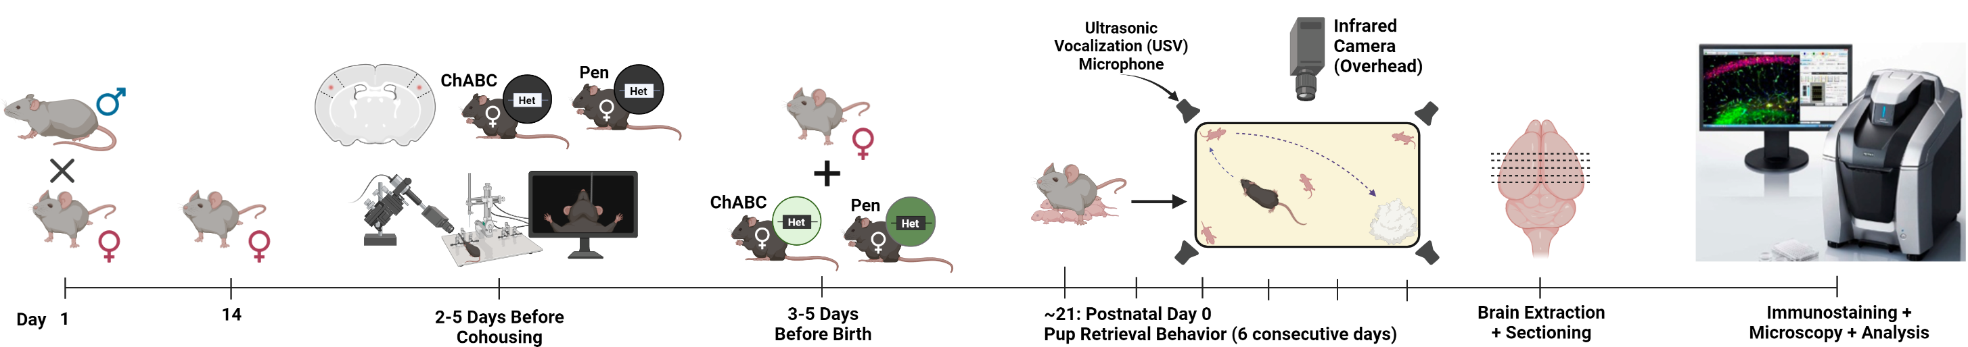
Method to reduce PNN expression in both S1BF hemispheres of NaïveHet
rostral
caudal
Designed by Logan Dunn, Biorender
Notes:
To address this question, I performed stereotaxic injection of chondroitinase ABC, or ChABC, into both hemispheres of S1BF of naïve Het 2-5 days prior to cohousing. The counterpart control naiveHet mice were injected with a control, nonfunctional enzyme in mammal, penicillinase. Then we cohouse and perform behavior as mentioned before. Brains are extracted and sectioned coronally on day 5 after behavior. Whole brain coronal sections are obtained and immunostained for PNNs and analyzed for PNN reduction.

Slide 5
Analysis of SS1 area with reduced PNN expression
ChABC-Treated Het
rostral
caudal
Per animal: ~ 35 tissues from rostral to caudal ≅ 70 hemispheres
Notes:
Here is an example of an epifluorescent image containing 15 coronal brain tissues showing both left and right hemispheres with PNN expression in green. For 1 animal, we have 3-4 images, totaling to about 35 brain tissues, with about 70 hemispheres to analyze for PNN degradation. An example of PNN degradation is showin by the 2 white lines.

Slide 6
Analysis of SS1 area with reduced PNN expression for each brain tissue
Pen-Treated
ChABC-Treated
1 mm
1 mm
Notes:
We know this is a PNN degraded region by comparing the ChABC-treated tissue to its control Pencillinase-treated animal

Slide 7
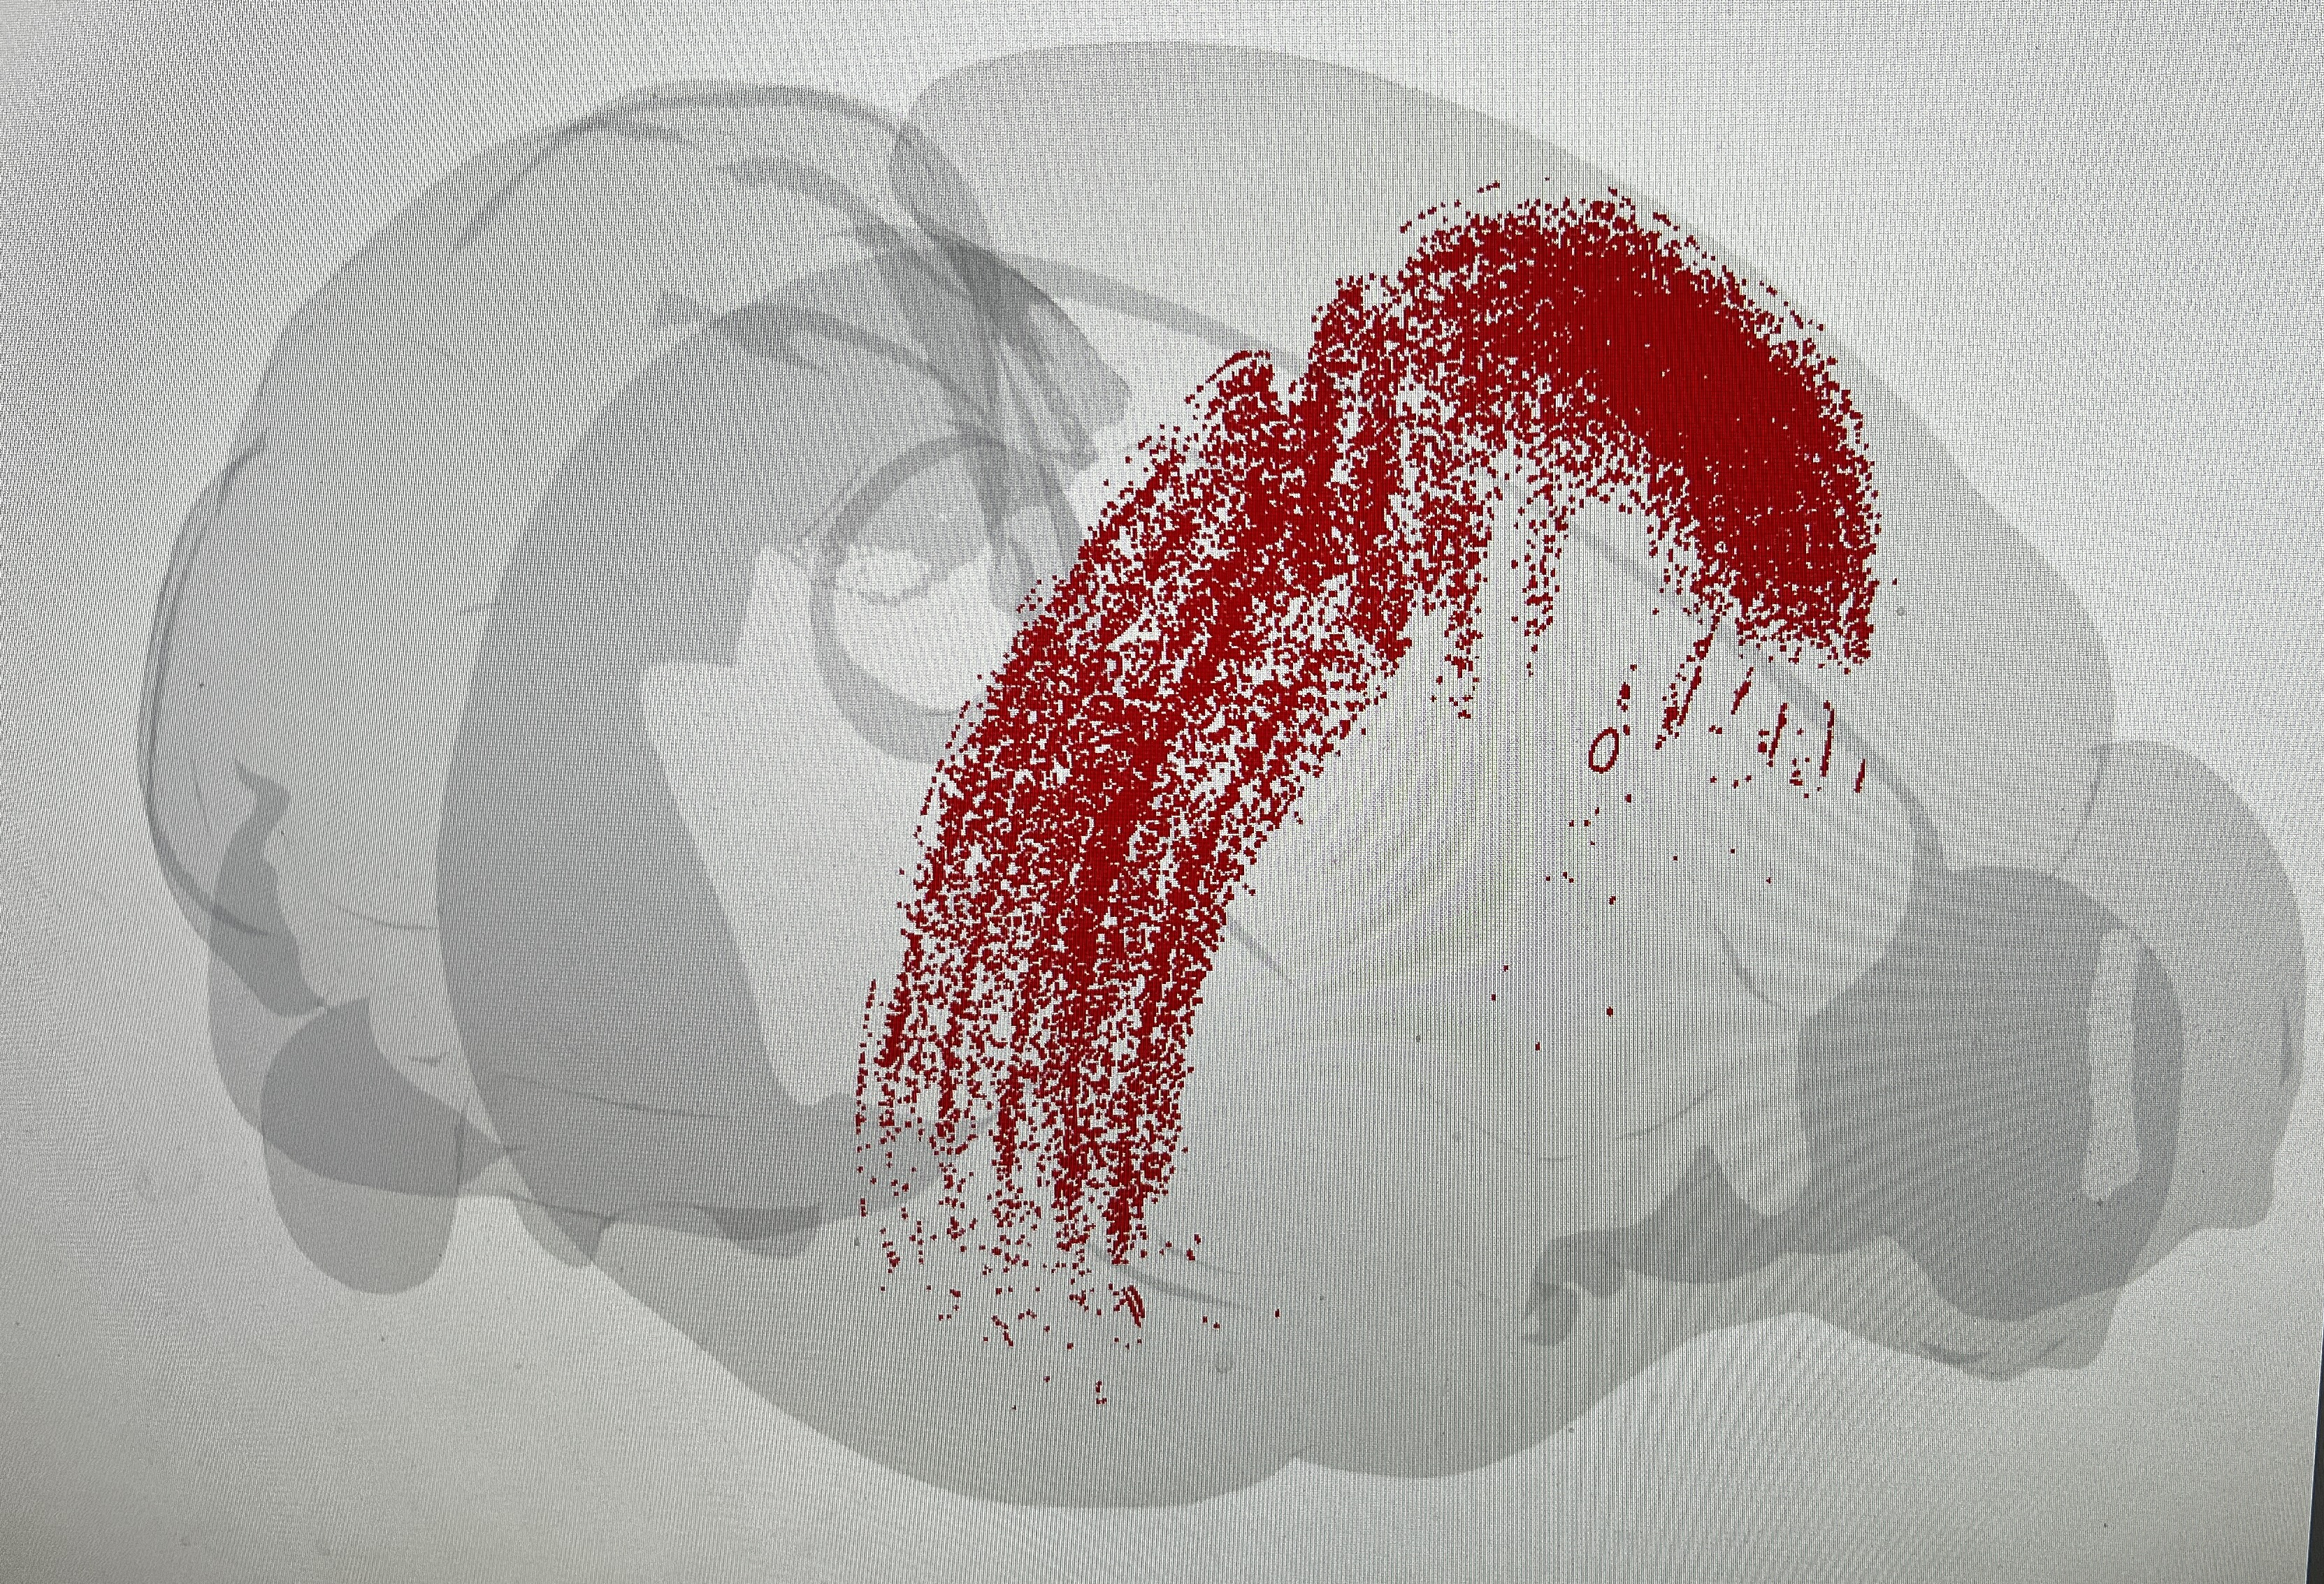
dorsal
caudal
rostral
ventral
Data from 5 brain images

Slide 8
Current dataset of WT-ChABC/Pen:
1. 16 cohorts of animals [1 cohort = one WT-ChABC and one WT-Pen (control)]
2. Behavior: 6 days of behavior
3. PNN images: ~35 images per WT-ChABC (rostral to caudal) (total ~560 images)
4. Number of SS1 subregions for analyzing PNN reduction: 8
SSp-bfd – Primary somatosensory area, barrel field
SSp-ll – Primary somatosensory area, lower limb
SSp-m – Primary somatosensory area, mouth
SSp-n – Primary somatosensory area, nose
SSp-tr – Primary somatosensory area, trunk
SSp-ul – Primary somatosensory area, upper limb
SSp-un – Primary somatosensory area, undefined
SSs – Supplementary somatosensory area

